Slide 1
Schedule
Week 7 (next week):
E-learning week: no class, no lab, no tutorials
Videos of Lecture will appear on ntuLearn
Recess Week
Week 8
Resume usual schedule
Notes:
Please turn up to LT20 on time.
Past exams for CA1 are on NTUlearn
Lecture next Thursday as usual

Slide 2
Set Theory
Part I/II

Slide 3

Outline
Definitions related to set:
Set, membership, empty set, set equality, subset, cardinality, power set
Venn diagram
Union, intersection
Cardinality
Cartesian product
Partition

Slide 4
Set
A set is a collection of abstract objects
Examples: prime numbers, domain in predicate logic
Determined by (distinct) elements/members.
E.g. {1, 2, 3} = {3, 1, 2} = {1, 3, 2}= {1, 1, 1, 2, 3, 3, 3}
Two common ways to specify a set
Explicit: Enumerate the members
e.g. A= {2, 3}
Implicit: Description using predicates {x|P(x)}
e.g. A = {x| x is a prime number}
Notes:
Even numbers: {x \in Z : 2 | x }

Slide 5
Membership & Subset
We write x∈S iff x is an element (member) of S.
e.g. A = {x| x is a prime number} then 2∈A, 3∈A, 5∈A,…,1∉A, 4∉A, 6∉A, …
A set A is a subset of the set B, denoted by A ⊆ B iff every element of A is also an element of B. i.e.,
A⊆B ≜ ∀x(x∈A→ x∈B)
A⊄B ≜ ¬ (A⊆B) ≡ ¬ ∀x(x∈A→x∈B) ≡ ∃x(x∈A ∧ x∉B)
Subset versus Membership: S = {rock, paper, scissors}
R = {rock}, R ⊆ S, rock ∈ S

Slide 6
Empty Set
The set that contains no element is called the empty set or null set.
The empty set is denoted by ∅ or by { }.
Note: ∅ ≠ {∅}
4/15

Slide 7
Set Equality
A=B ≜ ∀x(x∈A ↔ x∈B)
Two sets A, B are equal iff they have the same elements.
A≠B ≜ ¬∀x(x∈A ↔ x∈B)
≡ ∃x [(x∈A∧x∉B) ∨ (x∈B∧x∉A)]
Two sets are not equal if they do not have identical members, i.e., there is some element in one of the sets which is absent in the other.
Example:
{1, 2, 3} = {3, 1, 2} = {1, 3, 2}= {1, 1, 1, 2, 3, 3, 3}

Slide 8
Cardinality
The cardinality |S| of S is the number of elements in S.
e.g. for S={1, 3}, |S| =2
If |S| is finite, S is a finite set; otherwise, S is infinite.
The set of positive integers is an infinite set.
The set of prime numbers is an infinite set.
The set of even prime numbers is a finite set.
Note: |∅ | = 0
Notes:
Number of distinct elements.

Slide 9
Power Set
The power set P(S) of a given set S is the set of all subsets of S: P(S) = { A | A ⊆ S}.
Example
For S= {1,2,3} P(S)={∅,{1},{2},{3},{1,2},{1,3},{2,3},{1,2,3}}
If a set S has n elements, then P(S) has 2^{n} elements.
Hint: Try to leverage the Binomial theorem
Notes:
Bijection with binary vectors
Prove binomial theorem using induction

Slide 10
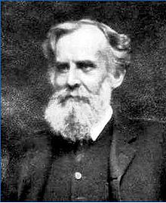
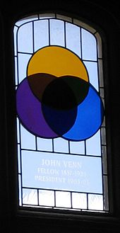
Venn Diagram
A Venn diagram is used to show/visualize the possible relations among a collection of sets.
John Venn
(1834-1923)

Slide 11
Union and Intersection
The union of sets A and B is the set of those elements that are either in A or in B, or in both.
A ∪B ≜ {x | x∈A ∨ x∈B}
The intersection of the sets A and B is the set of all elements that are in both A and B.
A ∩ B ≜ {x | x∈A ∧ x∈B}
B
A
B
A ∩ B
A
9/15

Slide 12

Disjoint Sets
Sets A and B are disjoint iff A ∩ B = ∅
|A ∩ B| = 0
What about me?
Lions
Fishes
Lions ∩ Fishes = ∅

Slide 13
Cardinality Of Union
⏐A ∪ B⏐ = ⏐A ⏐+ ⏐B ⏐- ⏐A ∩ B⏐
Notes:
{1,2} U {2,3} = {1,2,3}

Slide 14
Set Difference & Complement
The difference of A and B (or complement of B with respect to A) is the set containing those elements that are in A but not in B.
A − B ≜ {x | x∈A ∧ x∉B}
The complement of A is the complement of A with respect to U.
≜{x | x∉A}
A
U
12/15
Notes:
U is universe: largest set the contains all the elements that we are interested in.

Slide 15
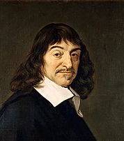
Cartesian Product
The Cartesian product AxB of the sets A and B is the set of all ordered pairs (a,b) where a ∈ A and b ∈ B.
A × B ≜ {(a,b) | a ∈ A ∧ b ∈ B}
Example: A = {1,2}, B = {x,y,z}
A × B = {(1,x), (1,y), (1,z), (2,x), (2,y), (2,z)}
B × A = {(x,1), (x,2), (y,1), (y,2), (z,1), (z,2)}
In general: A₁ × A₂ × … × A_{n} ≜{(a₁,a₂, … , a_{n}) | a_{i}∈A_{i} for i=1,2, …, n}
| A₁ × A₂ × … × A_{n} | = |A₁| |A₂ | … |A_{n} |
René Descartes
(1596-1650)
(z,2)
2
1
x
y
z
Notes:
I have heard that in previous years, the Cartesian product has caused lots of problems.

Slide 16
Partition
A collection of nonempty sets {A₁,A₂,…,A_{n}} is a partition of a set A, iff
and A₁, A₂, …, A_{n} are mutually disjoint, i.e.
A_{i} ∩ A_{j} = ∅ for all i, j = 1,2,…,n, and i ≠ j.
A₂
A₃
A₁
A
A₄
A₅
Notes:
{ {1}, {2}, {3,4} } partition of {1,2,3,4}
{ {1,2}, {2,3} } is not a partition

Slide 17
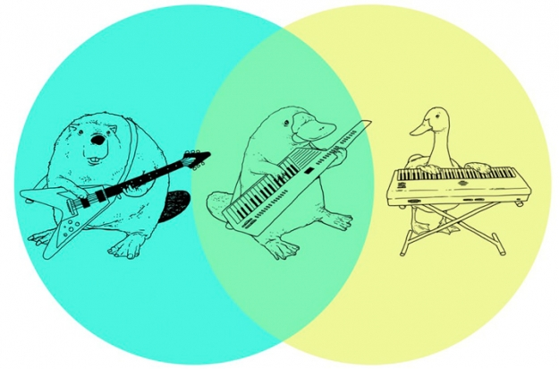
Summary
Sets
Membership, null set, equality, subset
Venn diagram
Set operations
Union, intersection, complement, difference, Cartesian product
Partition

